Slide 1
Spin Hall Magnetoresistance (SMR)
Evin O’Shea

Slide 2

Magnetoresistance (MR)
Resistance dependence on external magnetic field
Giant Magnetoresistance (GMR) has shown to be useful
  Albert Fert and Peter Grünberg
  The 2007 Nobel Prize in Physics

Slide 3
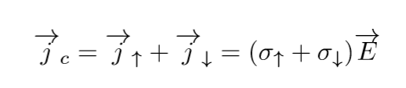

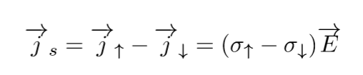
Electric and Spin Currents
Electric current:
Spin current:

Slide 4
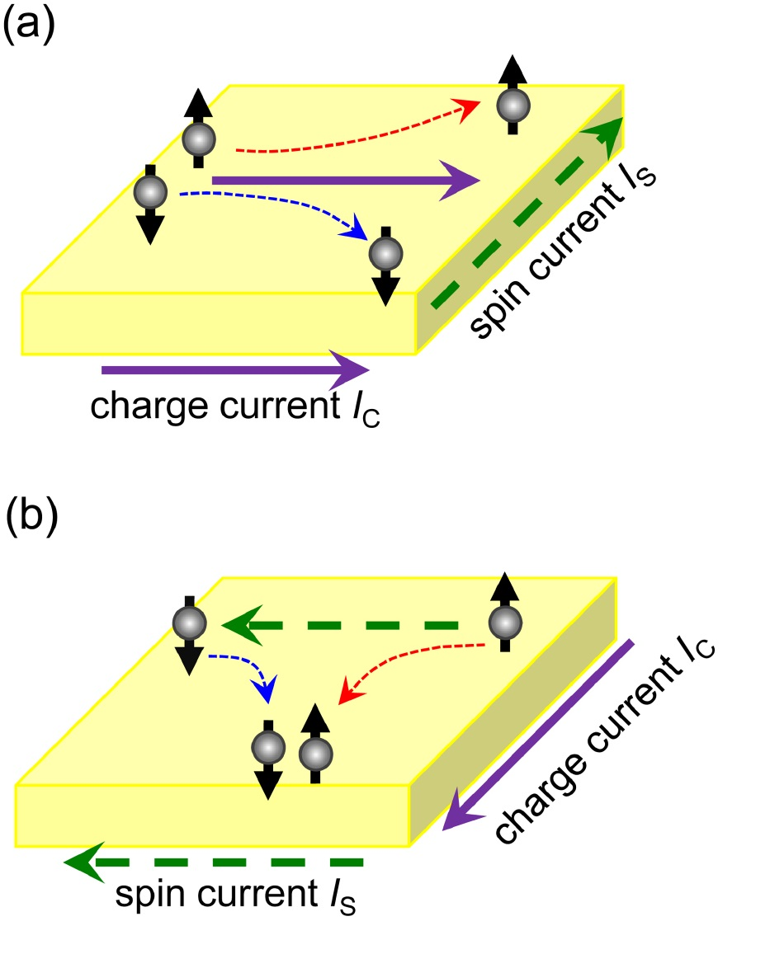
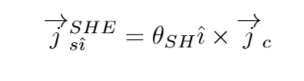
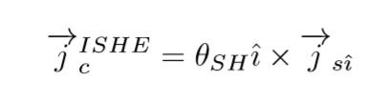
(Inverse) Spin Hall Effect (SHE/ISHE)
Spin Hall Effect:
Inverse Spin Hall Effect:

Slide 5
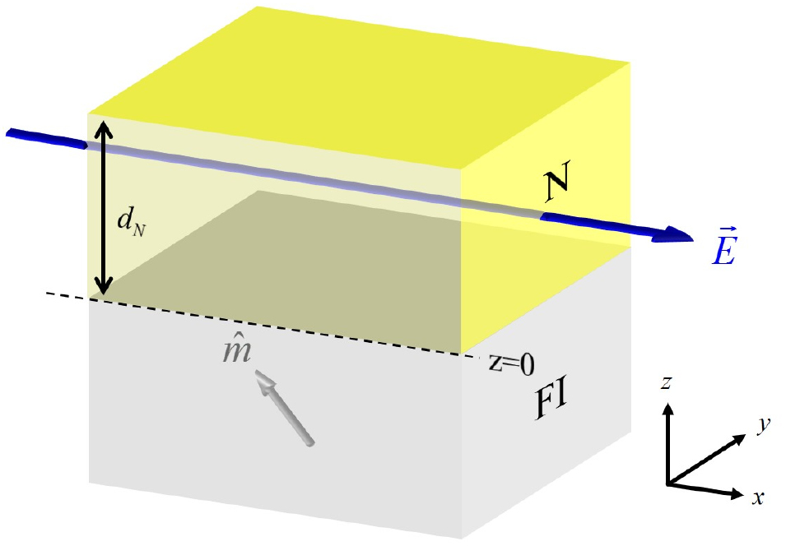
Discovery of SMR
Huang, et al
Normal metal and Ferromagnetic insulator
Platinum (Pt) and Yttrium Iron Garnet (YIG)
Ferromagnetic properties measured in Pt
Attributed Ferromagnetic properties to magnetic proximity effects (MPE)
Measured MR was thought to be anisotropic magnetoresistance (AMR)

Slide 6
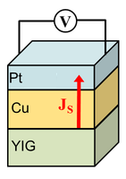
Identification of SMR
Nakayama, et al
Separated the Pt from the YIG
Cu would not react to MPE
Attributed ferromagnetic properties of Pt to SHE
Introduced SMR

Slide 7

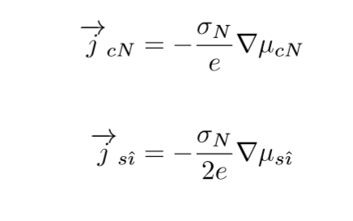
Chemical Potentials and Currents
Chemical potential:
Not including SHE/ISHE
In the normal metal:
  Charge Current:
  Spin Current:

Slide 8
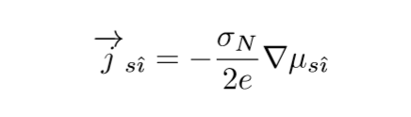
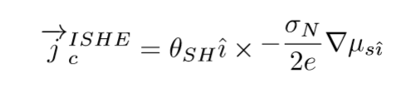
SMR as a Result of the SHE and ISHE
Formalized by Chen, et al
SHE and ISHE occurring at the same time
Replace source (spin) current in (I)SHE with the chemical potential as the source:

Slide 9
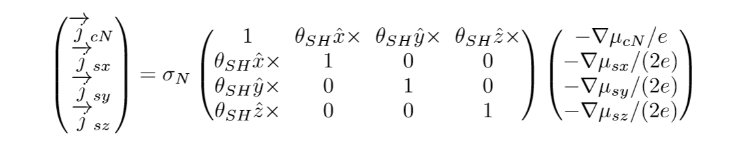
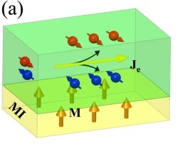
Formalization of SMR
The modified Ohm’s Law:
Boundary conditions are important, but very technical
Spin-mixing conductance at interface

Slide 10
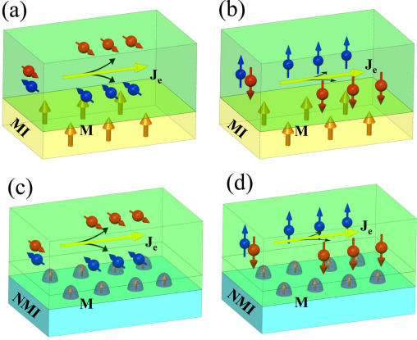
SMR Without a Ferromagnetic Insulator
Zhang, et al measured SMR in a bilayer of a normal metal and a non-magnetic insulator
Correct curve for SMR, not AMR
Stronger effect
Coincides well with the theory of SMR

Slide 11
References
Spin Hall magnetoresistance in an ultrathin Co2FeAl system Yan-qing Zhanga, Hua-rui Fub, Niu-yi Suna, Wen-ru Chea, Ding Dingc, Juan Qinc, Cai-yin Youb, Rong Shana, Zhen-gang Zhud. Journal of Magnetism and Magnetic Materials. Volume 411, 1 August 2016, Pages 103–107.
Theory of spin Hall magnetoresistance (SMR) and related phenomena. Yan-Ting Chen, Saburo Takahashi, Hiroyasu Nakayama, Matthias Althammer, Sebastian T B Goennenwein, Eiji Saitoh, and Gerrit E W Bauer. Published 16 February 2016 IOP Publishing Ltd. Journal of Physics: Condensed Matter, Volume 28, Number 10.
Transport Magnetic Proximity Effects in Platinum. S. Y. Huang, X. Fan, D. Qu, Y. P. Chen, W. G. Wang, J. Wu, T. Y. Chen, J. Q. Xiao, and C. L. Chien. Phys. Rev. Lett. 109, 107204 – Published 7 September 2012
Spin Hall Magnetoresistance Induced by a Nonequilibrium Proximity Effect. H. Nakayama, M. Althammer, Y.-T. Chen, K. Uchida, Y. Kajiwara, D. Kikuchi, T. Ohtani, S. Geprägs, M. Opel, S. Takahashi, R. Gross, G. E. W. Bauer, S. T. B. Goennenwein, and E. Saitoh. Phys. Rev. Lett. 110, 206601 – Published 13 May 2013
Enhancement of Pure Spin Currents in Spin Pumping Y3Fe5O12/Cu/Metal Trilayers through Spin Conductance Matching. Chunhui Du, Hailong Wang, Fengyuan Yang, and P. Chris Hammel. Phys. Rev. Applied 1, 044004 (2014) – Published 15 May 2014

